Slide 1
Litigation Options for Indigent Citizens
Earl McGowen

Slide 2
A Civil Action
Jan Schlictmann
Contingency Fee
Anthony Roisman
Public Interest Law Firm
Trial Lawyers for Public Justice

Slide 3
Who is represented?
Contingency Fee
Low Risk
High Reward
Public Interest
Broad Social Impact

Slide 4
Introduction
1. History of Legal Services Corporation
2. Legal Aid Organizations
3. Law School Clinics
4. Pro-bono Institutions

Slide 5
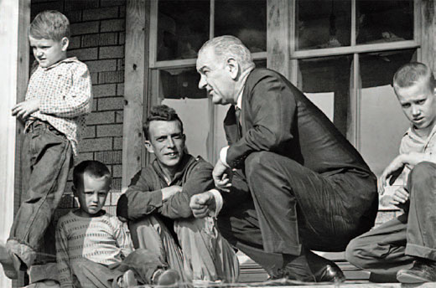
Legal Services Corporation
1900
1925
1950
1964
1975
2010
1964 – Economic Opportunity Act
President Johnson’s War on Poverty
Legal Services Corporation

Slide 6
Legal Services Corporation
1900
1925
1950
1964
1975
2010
LSC Success
King v. Smith (1968)
Federal law preempts state
Goldberg v. Kelley and Wheeler v. Montgomery
Procedural due process for welfare termination
Governor Reagan becomes openly hostile

Slide 7
Legal Services Corporation
1900
1925
1950
1964
1975
1996
2010
1996
Omnibus Consolidate Rescission and Appropriations Act
Two Things
Need to fill the gap
Limitations –
Class Actions, attorney’s fees, representation limits

Slide 8
Who is represented?
Contingency Fee
Low Risk
High Reward
Public Interest
Broad Social Impact
Legal Service Corporation
No Class Action
No Atty Fees
No criminal proceeding

Slide 9
Legal Aid organizations
Corporations
1864
Legal Aid Society of New York
German Society of New York
In Colorado
Legal Aid Foundation of Colorado
National Legal Aid and Defender Program

Slide 12
Conrol by funders
Colorado Rules of Professional Conduct
5.4
(c) A lawyer shall not permit a person
who recommends, employs, or pays the lawyer to render legal services for another
to direct or regulate the lawyer’s professional judgment in rendering such legal services.
1.8(f)
A lawyer shall not accept compensation for representing a client from one other than the client unless:
(2) there is no interference with the lawyer's independence of professional judgment or with the client lawyer relationship

Slide 13
Who is represented?
Contingency Fee
Low Risk
High Reward
Public Interest
Broad Social Impact
Legal Service Corporation
No Class Action
No Atty Fees
No criminal proceeding
Legal Aid
Not Unpopular
Supports Business Interest

Slide 14
Filling the GAP
1900
1925
1950
1964
LSC FUNDS
1975
1996
2010
Law School Clinics
Pro Bono

Slide 15
Law School Clinics
ABA 1996 amendments
Standard 302 (b)
(b) A law school shall offer substantial opportunities for:
(1) live-client or other real-life practice experiences
….
(2) student participation in pro bono activities; and

Slide 16
Law School Clinic
1970s - University of Connecticut's law school clinic
ABA Informal Ethics Opinion 1208
case-by-case prior approval violated the professional ethics
prevent representing war protestors and other unpopular clients
Colorado
James Watt
Mountain States Legal Foundation
Legislation: prohibited “law professors at the University of Colorado from assisting in litigation against a governmental unit or political subdivision.”

Slide 17
Pro Bono
Colorado Rules of Professional Conduct
1993
A lawyer “should aspire to render at least (50) hours of pro bono public legal services per year”

Slide 18
Pro Bono
Colorado Rules of Professional Conduct
RULE 1.7. CONFLICT OF INTEREST: CURRENT CLIENTS
(a) Except as provided in paragraph (b), a lawyer shall not represent a client if the representation involves a concurrent conflict of interest. A concurrent conflict of interest exists if:
(2) there is a significant risk that the representation of one or more clients will be materially limited by the lawyer's responsibilities to another client, a former client or a third person or by a personal interest of the lawyer.

Slide 19
Pro Bono
Pro Bono Refferal Services
Refer Lawyers from firms
Train in areas of law
Provide Scripts

Slide 21
911 Engagement Letter
Arranging funerals and burials, applying for aid, administering estates, and finding new homes and jobs.
Preventing litigation against possible business targets.

Slide 22
Who is represented?
Contingency Fee
Low Risk
High Reward
Public Interest
Broad Social Impact
Legal Service Corporation
1964
1996 Losses
Legal Aid
Popular
Supports Business Interest
Pro-Bono
Not Adverse Client

